Slide 1

GOLD PRICE PREDICTION USING MACHINE LEARNING
Project Supervisor: Dr. Sathyapriya L, M.E., Ph.D.,
Name of the Student: Mr.Kurella Guna Shankar
Register Number: 39110556

Slide 2
Presentation Outline
Course Certificate
Introduction
Objectives
System Architecture / Ideation Map
Module Implementation
Application Snapshots
Results and Discussions
Conclusion & Future work
References

Slide 3
Course Certificate
Attach your Course Certificate here

Slide 4
Introduction
Gold price prediction is the application of science and
technology to predict the future gold price.
It is important because gold is one of the precious metals that is used for funding trading purchases. The countries with gold deposits are considered as the prosperous nations and our prediction models will also be beneficial for investors, and central banks to decide when to invest in this commodity
Hence we use machine learning algorithm for analyzing the relation between the variables and predict the gold price.

Slide 5
Objectives
The objective of this project is to predict The future gold prices.
In machine learning I’m going to use random forest regression to achieve our objective.
By using random forest regression we get the objective and shown it in the form of a gui.

Slide 6
System Architecture / Ideation Map
START
Gol prices
dataset
Data visualization
Normalizing the data
By using random forest regression training the data
Train
(80%)
Stop
Predicting data by using random forest regression
Test
(20%)
Result

Slide 7
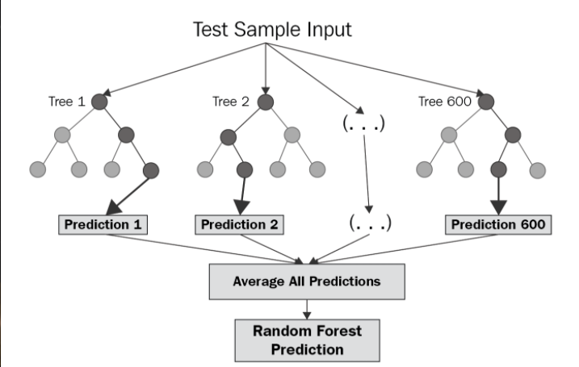
System Architecture / Ideation Map

Slide 8
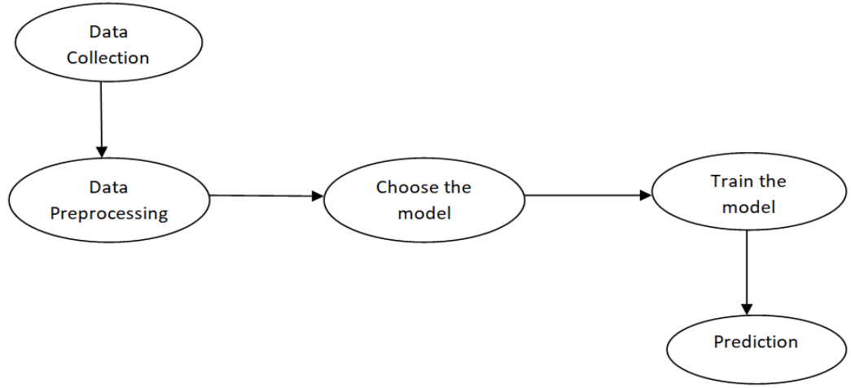
Project Implementation
MODULE IMPLEMENTATION:
To predict the gold price, we need to build a machine learning model which includes the following steps

Slide 9
Project Implementation
Data Collection: The first thing required while building a machine learning model is the data. The data is collected from the web consisting of 2290 records and 8 attributes.
Data Preprocessing: Data preprocessing is required when the data is incomplete, inconsistent, or noisy. The data collected was noisy, so we performed an outlier analysis and removed the noisy data. The data transformation is also done by performing normalization in which the data in each attribute is scaled between the range 0 to 1.
Choose the model: Prediction of gold price is a regression task, so we consider the regression algorithm called Random Forest Regressor for building the model

Slide 10
Project Implementation
Training the model: The model is trained by importing the required model and bypassing the training data to it. The dataset is splitted into train and test data with test_size=0.20. The Random forest regressor modules are imported from sklearn.ensemble.
The model is trained by passing the train data. While conducting training, it is also important to record the metrics of each training process. The metrics that are tested are mean absolute error, root mean square error and r2 score.
Prediction: The trained model is checked by predicting the test data of the dependent variable using the test data of the independent variables.

Slide 11
Project Implementation
Construction :
Problem statement
Importing the libraries
Loading the dataset
Data Insights
Summary Statistics
Data visualization
Understanding the target variable
Fitting the Models
Checking model accuracy

Slide 12
Project Implementation
Hardware requirements
CPU: 2 x 64-bit 2.8 GHz 8.00 GT/s CPUs
RAM: Min of 4GB required(or 16 GB of 1600 MHz DDR3 RAM)
Storage: 300 GB. (600 GB for air-gapped deployments.) Additional space is recommended if the repository will be used to store packages built by the customer. With an empty repository, a base install requires 2 GB.
Internet access to download the files from Anaconda.org or a USB drive containing all of the files you need with alternate instructions for air-gapped installations.

Slide 13
Project Implementation
Software & system requirements:
Jupyter notebook(need to install anaconda software to run jupyter notebook in our machine) or google colab(can run directly on the web).
Client environment maybe Windows, macOS or Linux
MongoDB 2.6 (provided)
Anaconda Repository license file
Visual studios(available in anaconda software) used to represent GUI screens using local servers.
Linux system accounts
mongodb (RHEL) or MongoDB (Ubuntu)
anaconda-server

Slide 14

Application Snapshots
WELCOME PAGE INTERFACE:

Slide 15
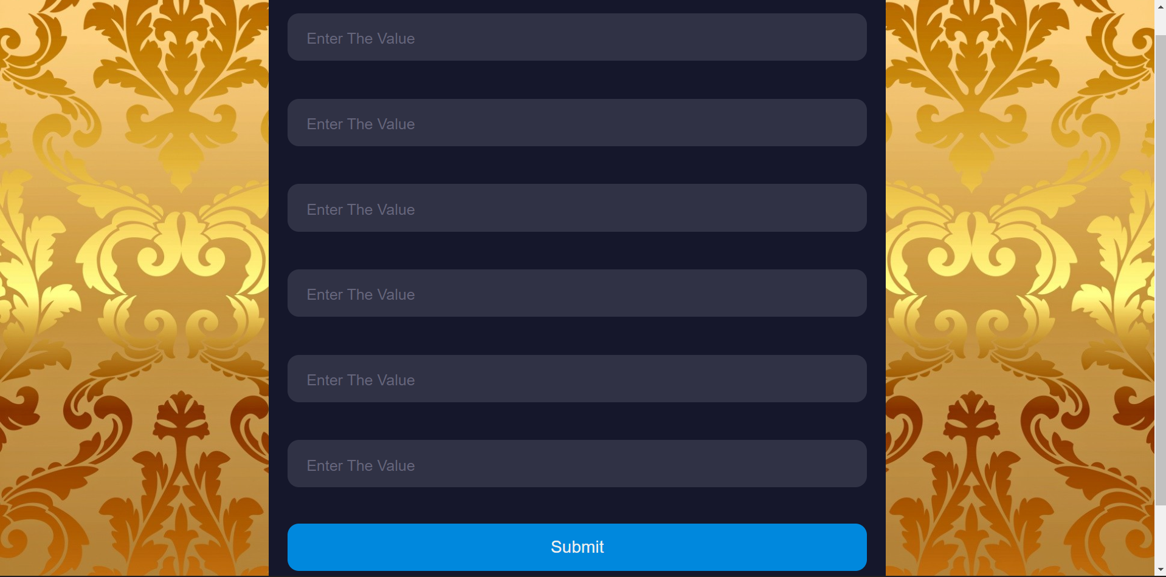
Application Snapshots
INPUT INTERFACE:

Slide 16

Application Snapshots
OUTPUT PAGE INTERFACE:

Slide 17
Project Implementation
Interpretation of result:
Machine learning models achieved significantly higher prediction accuracy
Over common clinical risk scores , By using the Random forest regression model
We achieve an R Squared error Score of 0.99% which is high(It lies between 0-1)

Slide 18
Methodology
For developing the model, we used the Random forest regression algorithm.
RANDOM FOREST REGRESSION :
Random forest regression is a supervised learning algorithm that uses ensemble learning method for regression. Ensemble learning method is a technique that combines predictions from multiple machine learning algorithms to make a more accurate prediction than a single modelA Random Forest is an ensemble technique capable of performing both regression and classification tasks with the use of multiple decision trees and a technique called Bootstrap and Aggregation, commonly known as bagging.

Slide 19
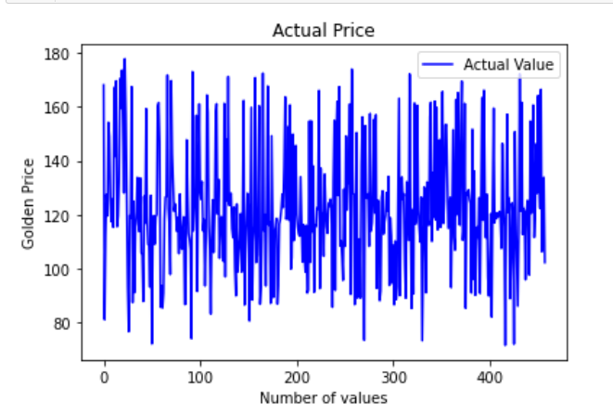
Results and Discussion
Gold prices plot before prediction:

Slide 20
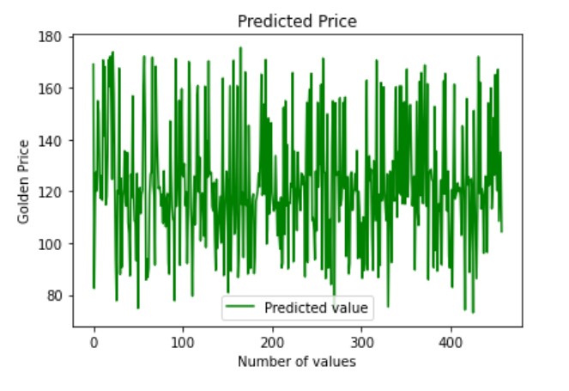
Results and Discussion
Gold prices plot after prediction:

Slide 21
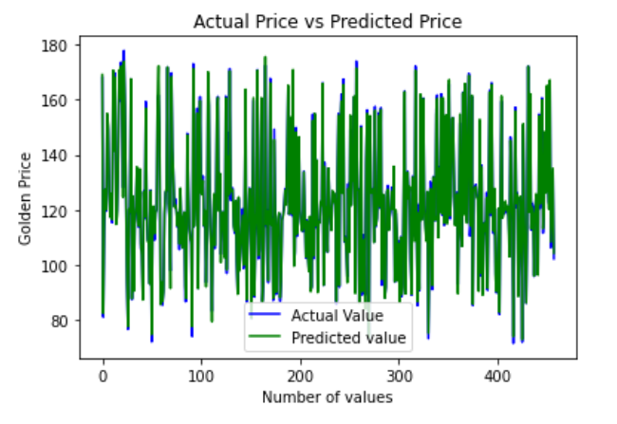
Results and Discussion
Actual prices vs predicted price:

Slide 22
Conclusion
Gold has been one of the most important commodities throughout history. Maintaining gold reserves by central banks is crucial to support the current economic structure of the world
Some major companies and investors also invest a huge amount of money in gold. Although not easy, predicting the rate of gold would help investors and central banks to better decide when to sell and buy it.
we used machine learning algorithms to predict the gold rates very accurately.

Slide 23
Conclusion
The main aim of this project is to predict the gold price, that is influenced by the economic variables such as stock profit exchange, silver price, EUR/USD, and United States oil ETF.
The machine learning algorithm random forest regressor is used to predict the price of gold accurately. Considering the results obtained, we conclude that the random forest regression model performed well.
We achieve an R Squared error Score of 0.99% which is high(It lies between 0-1)

Slide 24
References
[1] | Gold rate prediction or forecast for today, Tomorrow, Next 30 days, months &amp; more. Top 10 stock brokers in India - Compare Top share broker of 2020. (2022, April 9). Retrieved April 9, 2022, from https://top10stockbroker.com/gold-rate/gold-rate-forecast/
[2] | China's government doesn't share exact figures. (n.d.). China is on a massive gold buying spree. CNNMoney. Retrieved April 9, 2022, from https://money.cnn.com/2016/02/10/investing/china-gold/
[3] | Business Standard. (n.d.). Gold price Today in Delhi, India, Gold Rate Today, gold price today rates in India. Business Standard. Retrieved April 10, 2022, from https://www.business-standard.com/about/what-is-gold-price
[4] | Python tutorial. (n.d.). Retrieved April 9, 2022, from https://www.tutorialspoint.com/python/index.htm

Slide 25
References
[5] | Bakshi, C. (2020, June 9). Random Forest regression. Medium. Retrieved April 9, 2022, from https://levelup.gitconnected.com/random-forest-regression-209c0f354c84
[6] | Historical gold rate/trend in India - complete information. Bankbazaar. (n.d.). Retrieved April 9, 2022, from https://www.bankbazaar.com/gold-rate/gold-rate-trend-in-india.html
[7] | World Gold Council. (2022, April 8). Gold spot price and cost of gold. World Gold Council. Retrieved April 9, 2022, from https://www.gold.org/goldhub/data/gold-prices
[8] | https://goldprice.org/gold-price-data.html

